Slide 1
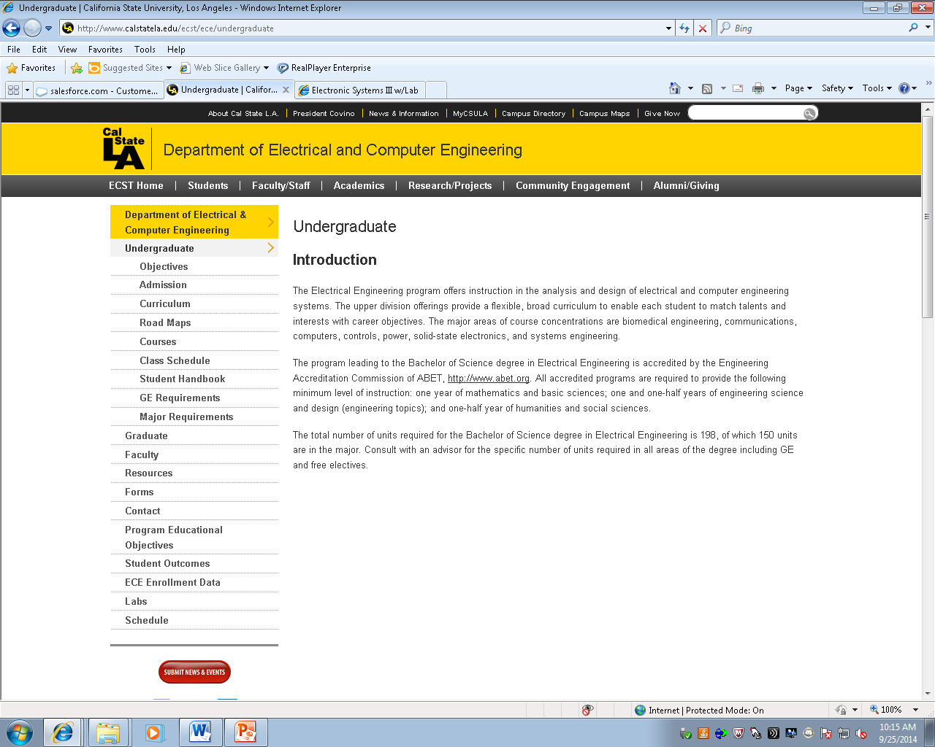
EE 4130
CSULA
Prof. Joel K. Harris
22 January 2018
Lecture 1

Slide 2
Instructor/Professor Introduction/Backstory
~ 17 years as a systems engineer in aerospace/defense industry in So. California (e.g. Rocketdyne (2x), Mykotronix, Raytheon SAS)
B.S. degree in EE(T) 1997, M.S. in Systems Engineering 2008.
Have taught for ~ 4 years at CSULA in ECST Dept.
Married, one (step)daughter, live near Thousand Oaks, CA
Hobbies: solar astronomy, math, electronics projects

Slide 3
EE 413 Objectives
Render an overview of the systems engineering process.
Develop an understanding of how SE is used in system design, verification, validation, production, and [eventual] system retirement
Provide you with practical exercises in exploring different elements of the systems engineering process (e.g. requirements development, risk assessment, trade study methodologies, verification methods, etc.)

Slide 4
EE 413 Ground Rules/Terms of Engagement
Please be on time for start of class
After this week, choose a specific seat in the classroom and please use that same location for the entire course
Respect your fellow students’ right to ask questions and share the discourse …
For examinations/quizzes to be handed in, be sure to place your name and CIN on the front page of the test…
During any test/exam, there will be no talking, looking at others’ papers, or use of electronic communication devices… Violation of any of these rules will result in significant consequences…

Slide 5
So, what IS A “System”??
  “A set of interrelated components functioning together toward some common objective or purpose.”
  System elements are: a) components, b) attributes, and c) relationships [between components]
  Systems alter either energy, information or materials
  Systems can be either natural, or man-made
  Systems can be either physical or conceptual
  Systems are typically static or dynamic

Slide 6
Definitions of what is Systems Engineering?
  “It’s what systems engineers do”…. *
  “Systems Engineering is an interdisciplinary approach and means to enable the realization of successful systems. It focuses on defining customer needs and required functionality early in the development cycle, documenting requirements, then proceeding with design synthesis and system validation while considering the complete problem.” **
  “Transformation of an operational need into a description of system performance parameters and a system configuration…” ***
* H. Bode 1967
** INCOSE
*** DSMC

Slide 7
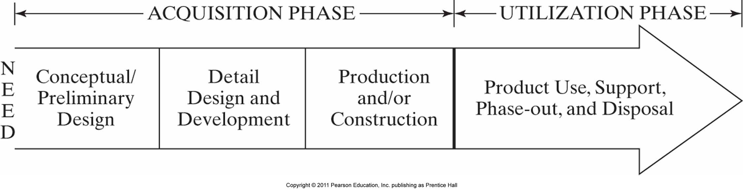
The Product Life Cycle

Slide 8
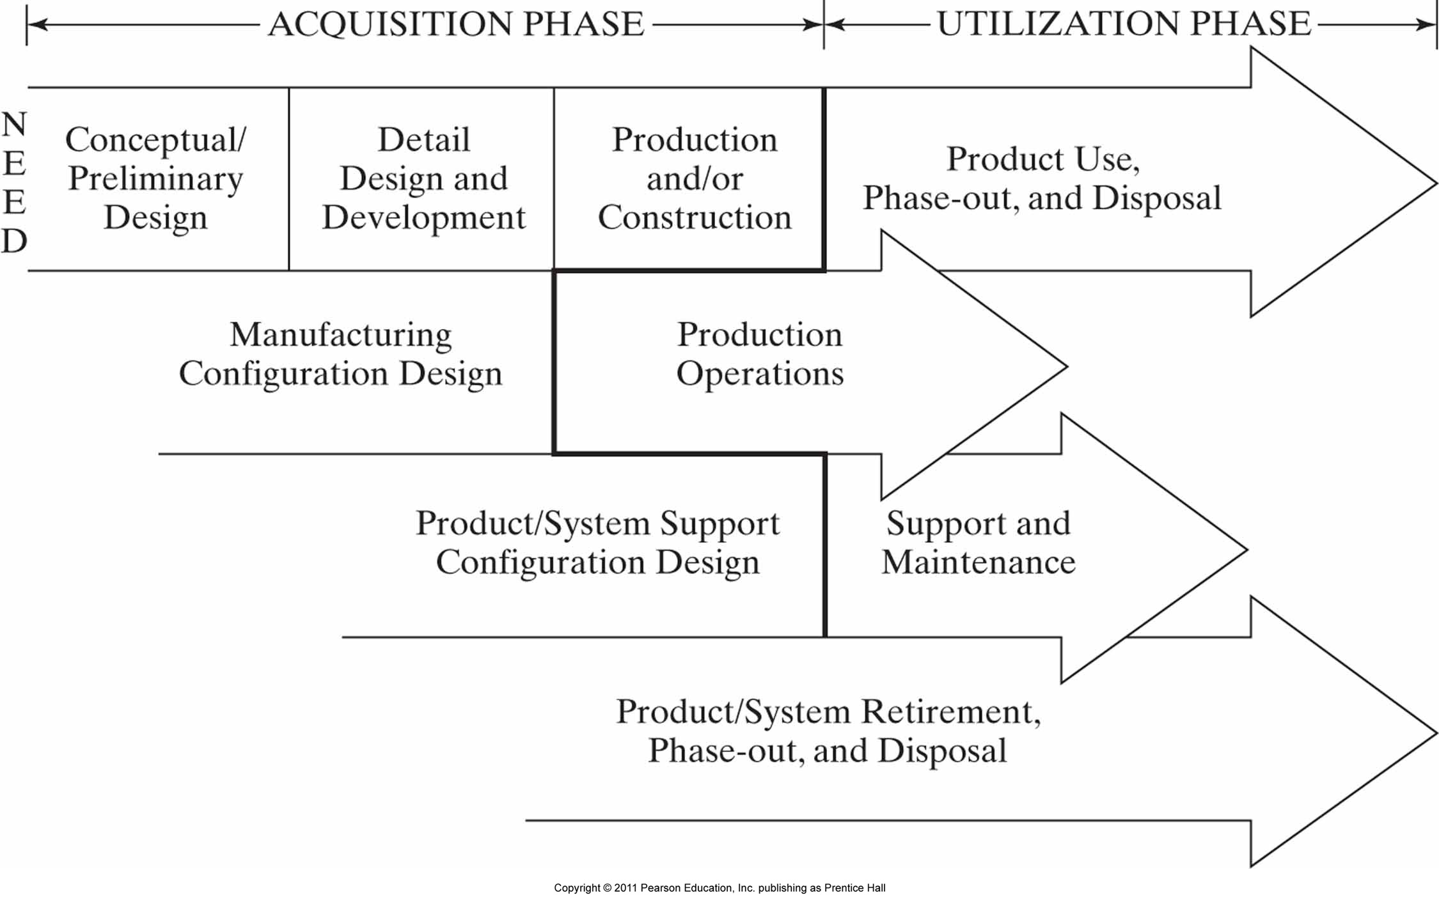
Life Cycles Of A System - Detail

Slide 9
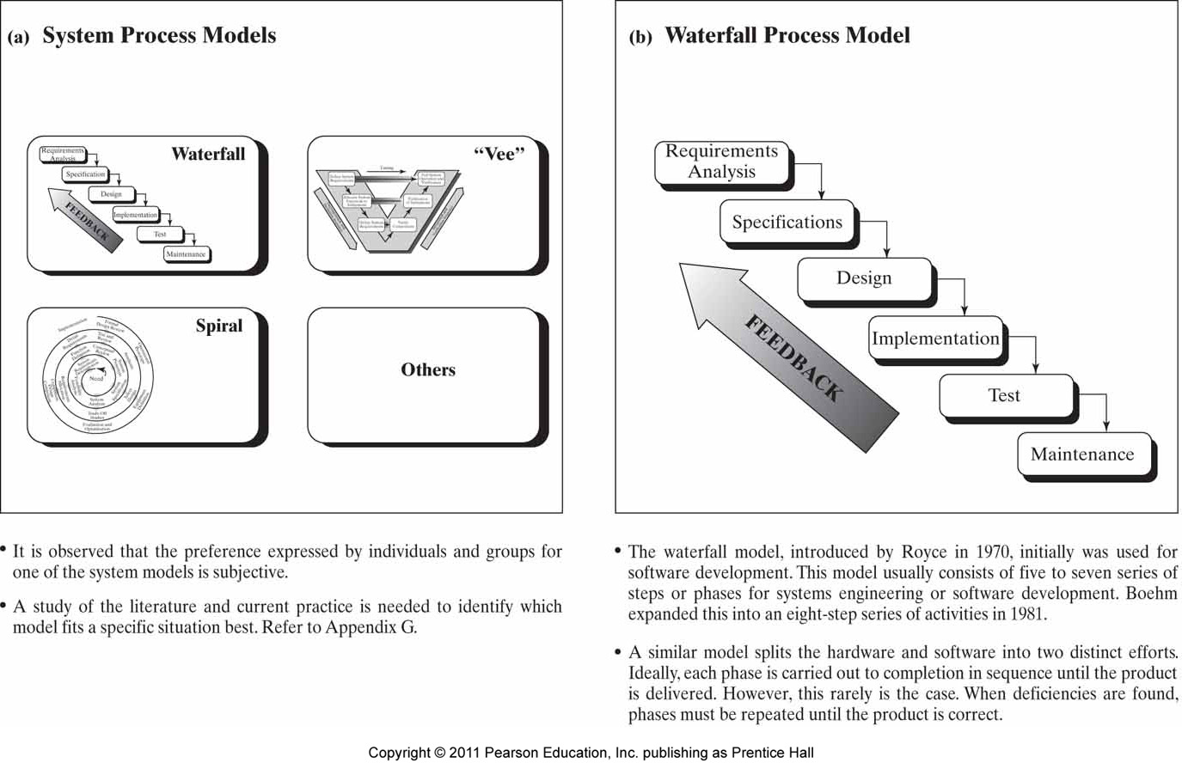
Some Common Systems Engineering Process Models

Slide 10
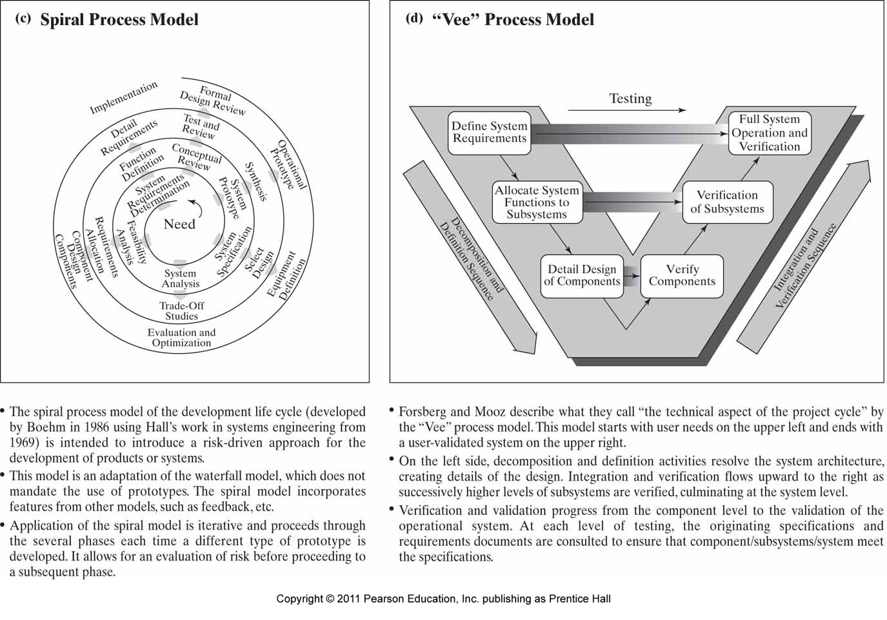
Systems Engineering Process Models (cont’d)

Slide 11
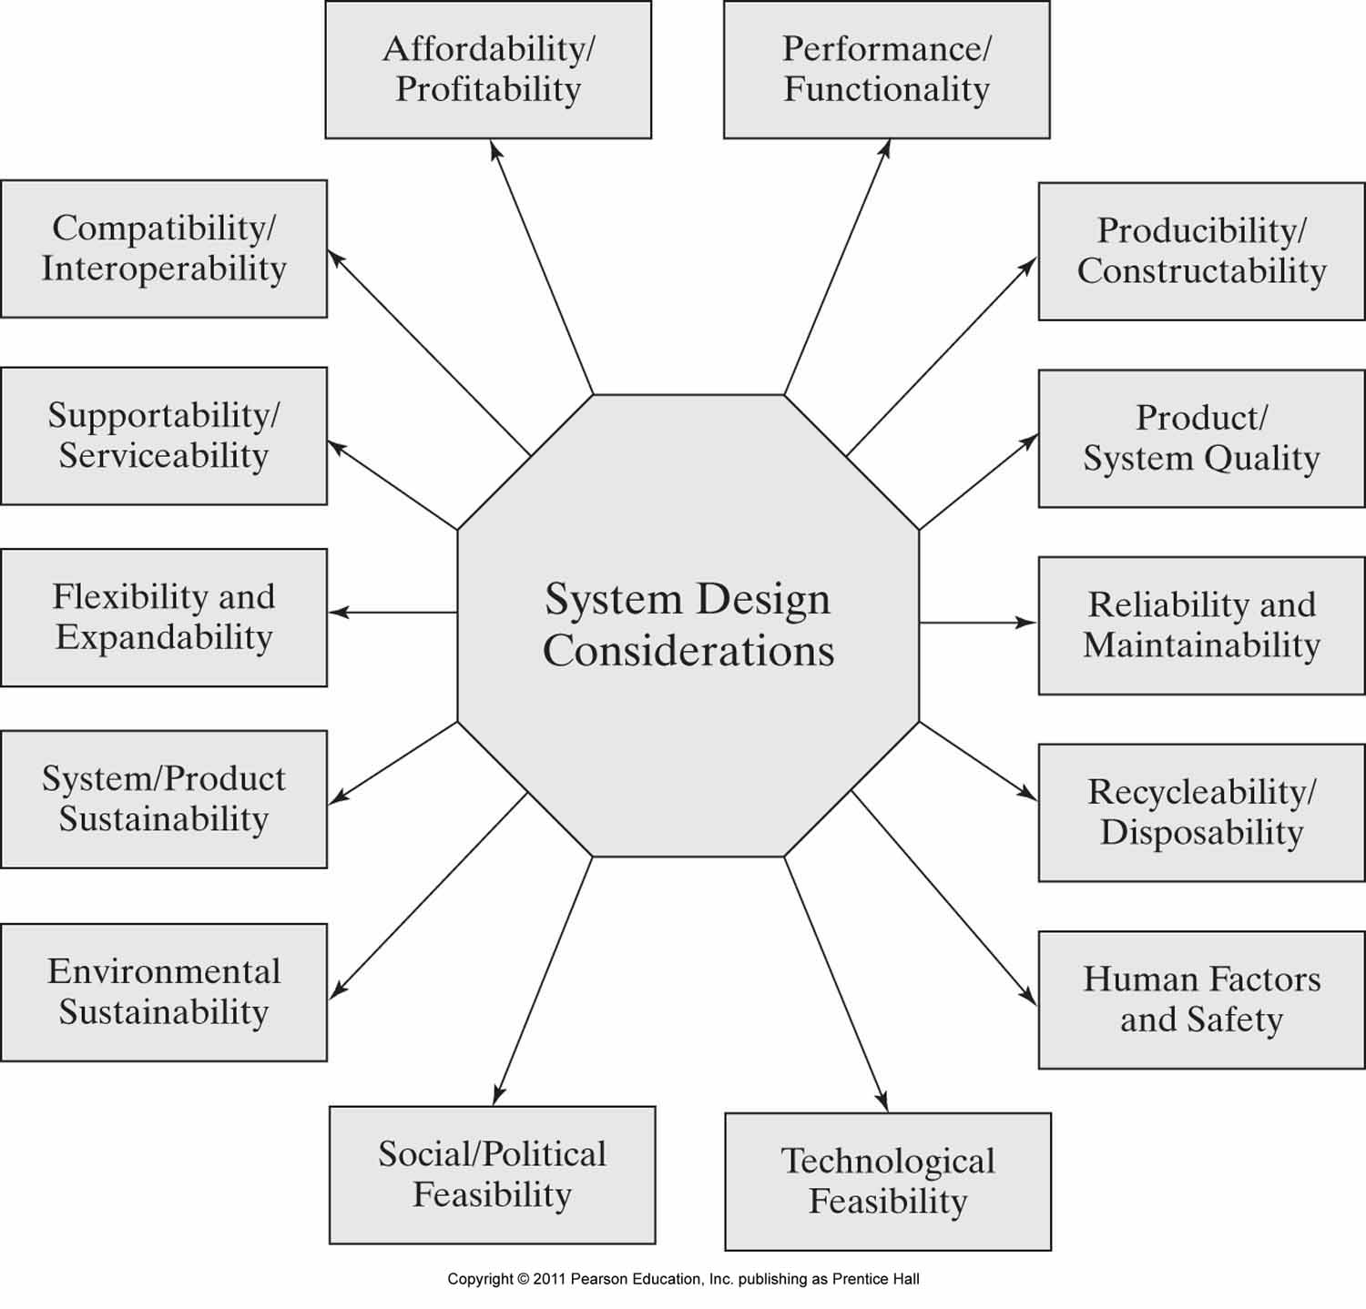
Some System Design Considerations

Slide 12
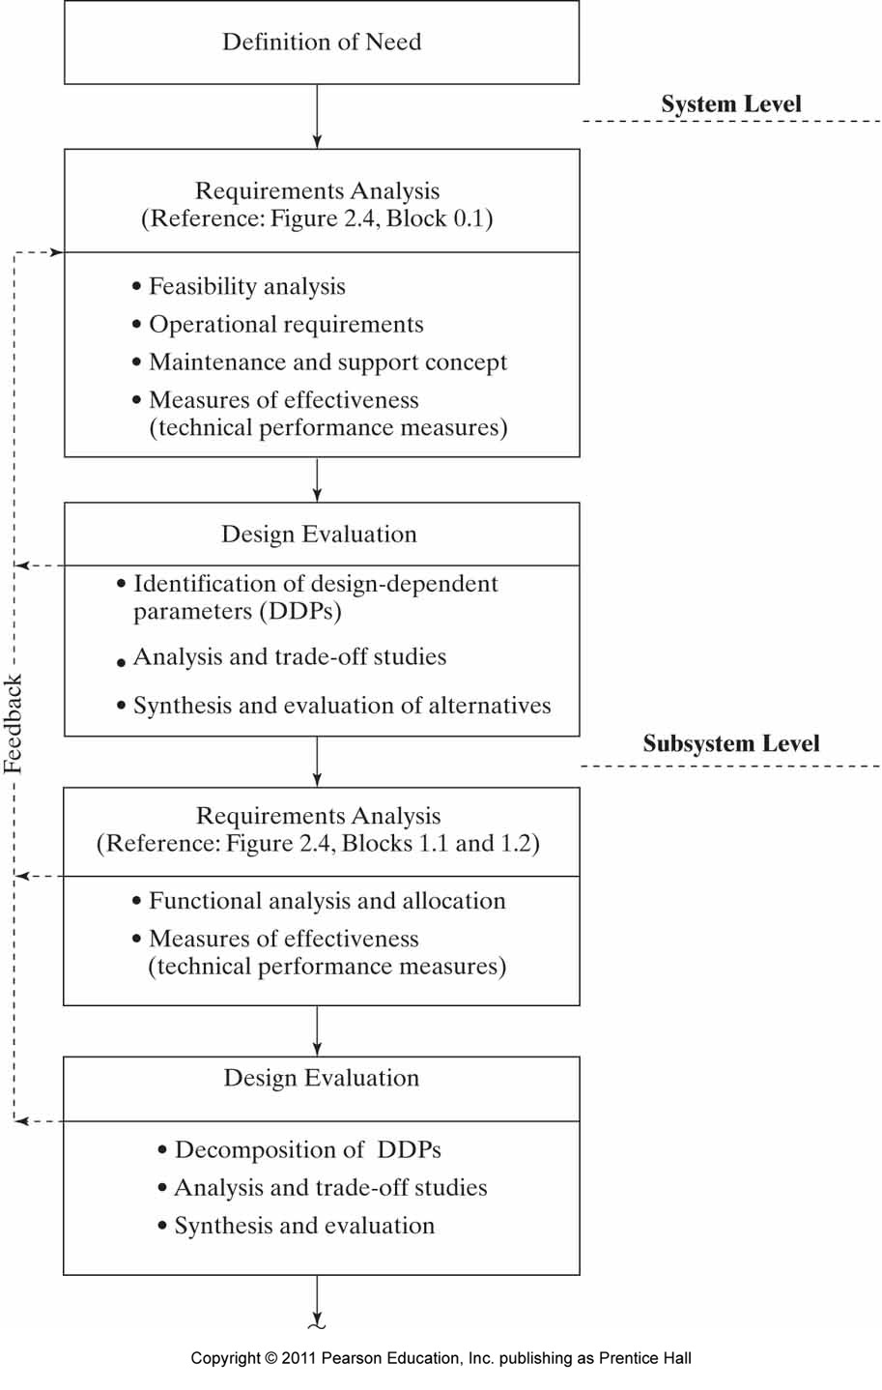
Decomposing System Design Requirements

Slide 13
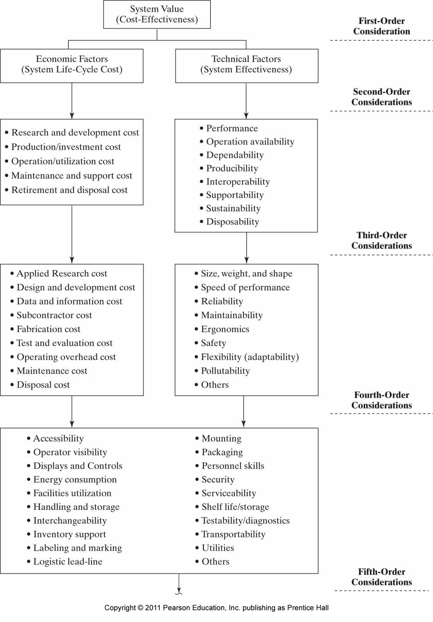
A Hierarchy Of System Design Considerations

Slide 14
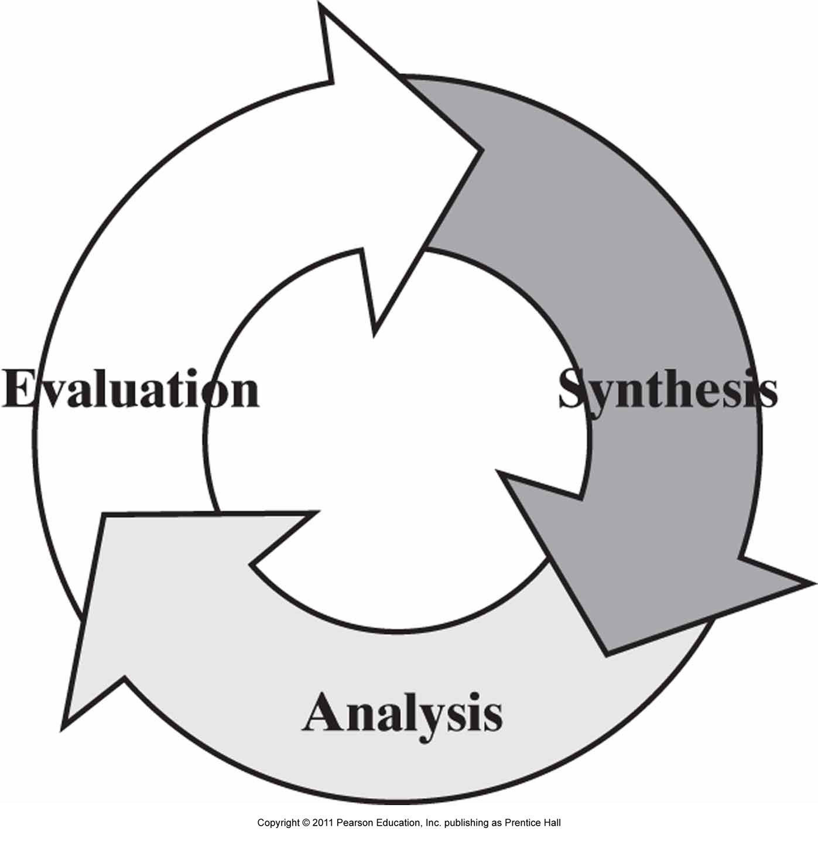
The System Engineering Work Model

Slide 15
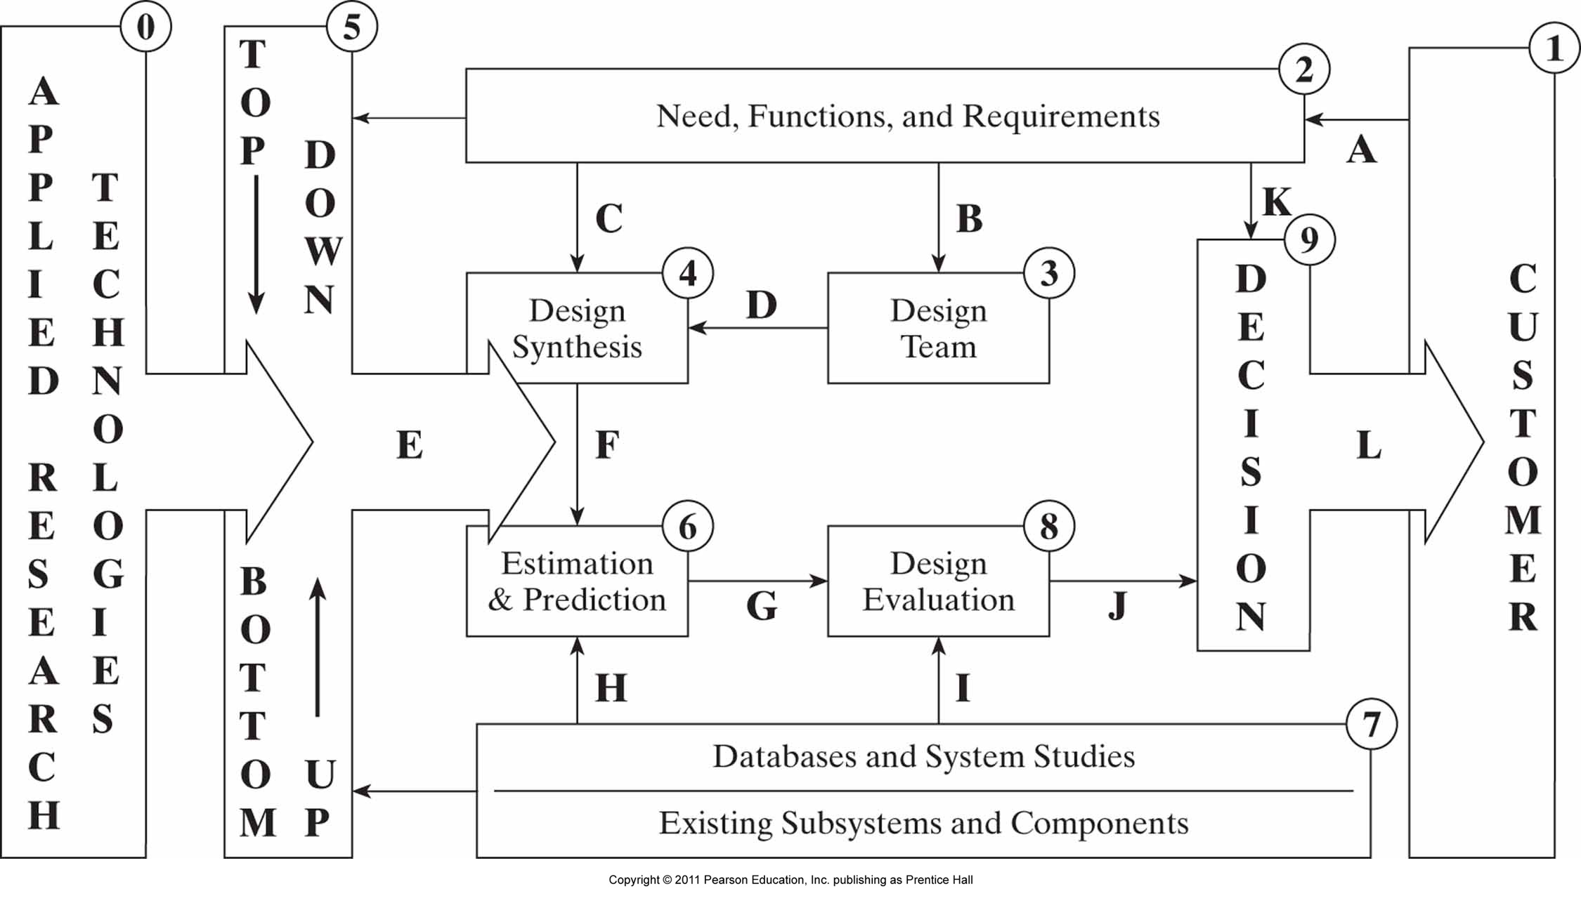
Systems Engineering Morphology For Product Realization

Slide 16
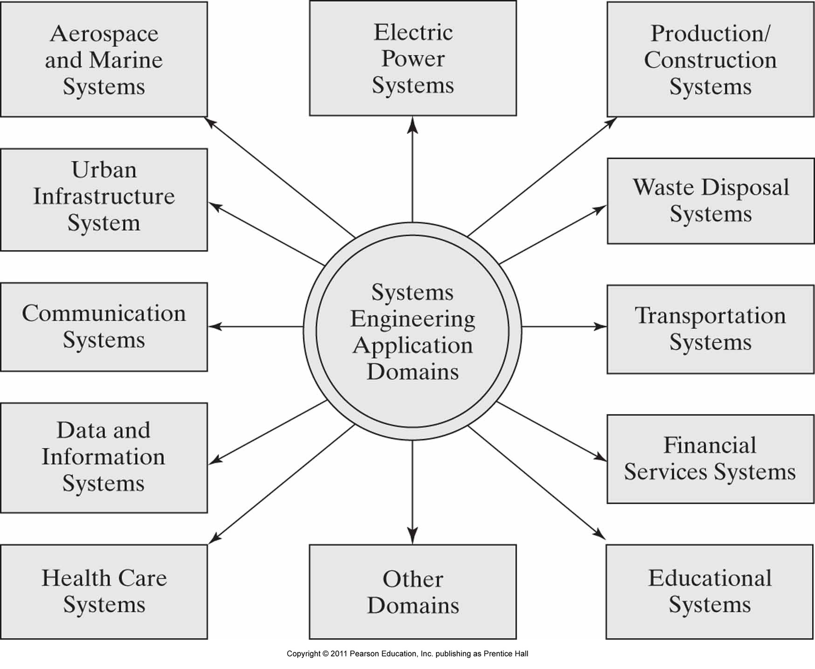
Application Domains For Systems Engineering

Slide 17
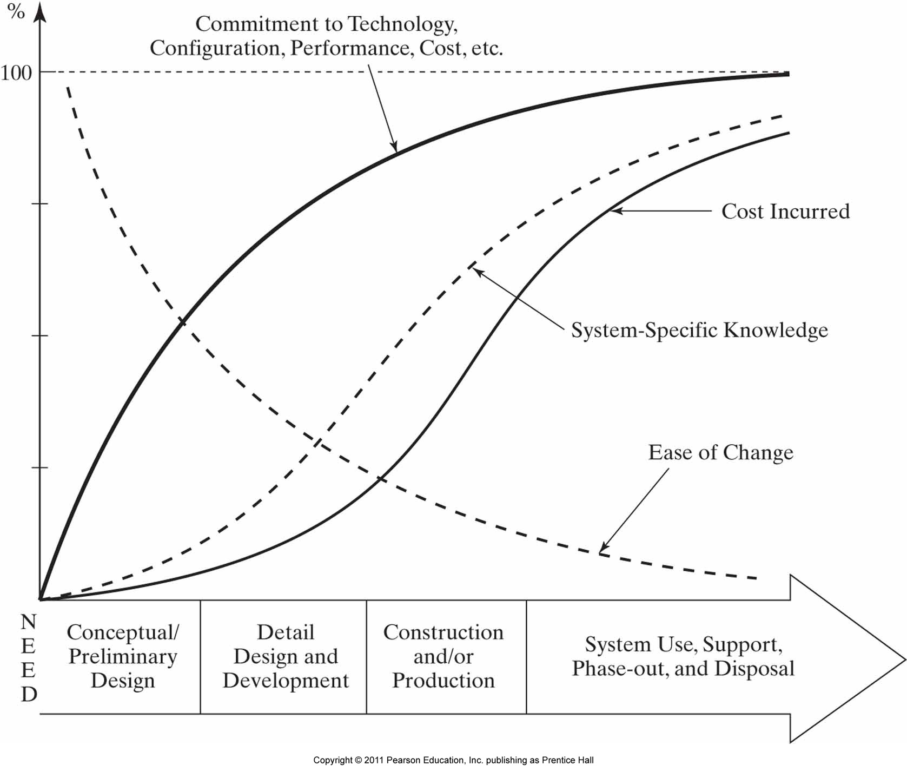
System Life-cycle Commitment, System-specific Knowledge,
And Incurred Cost

Slide 18
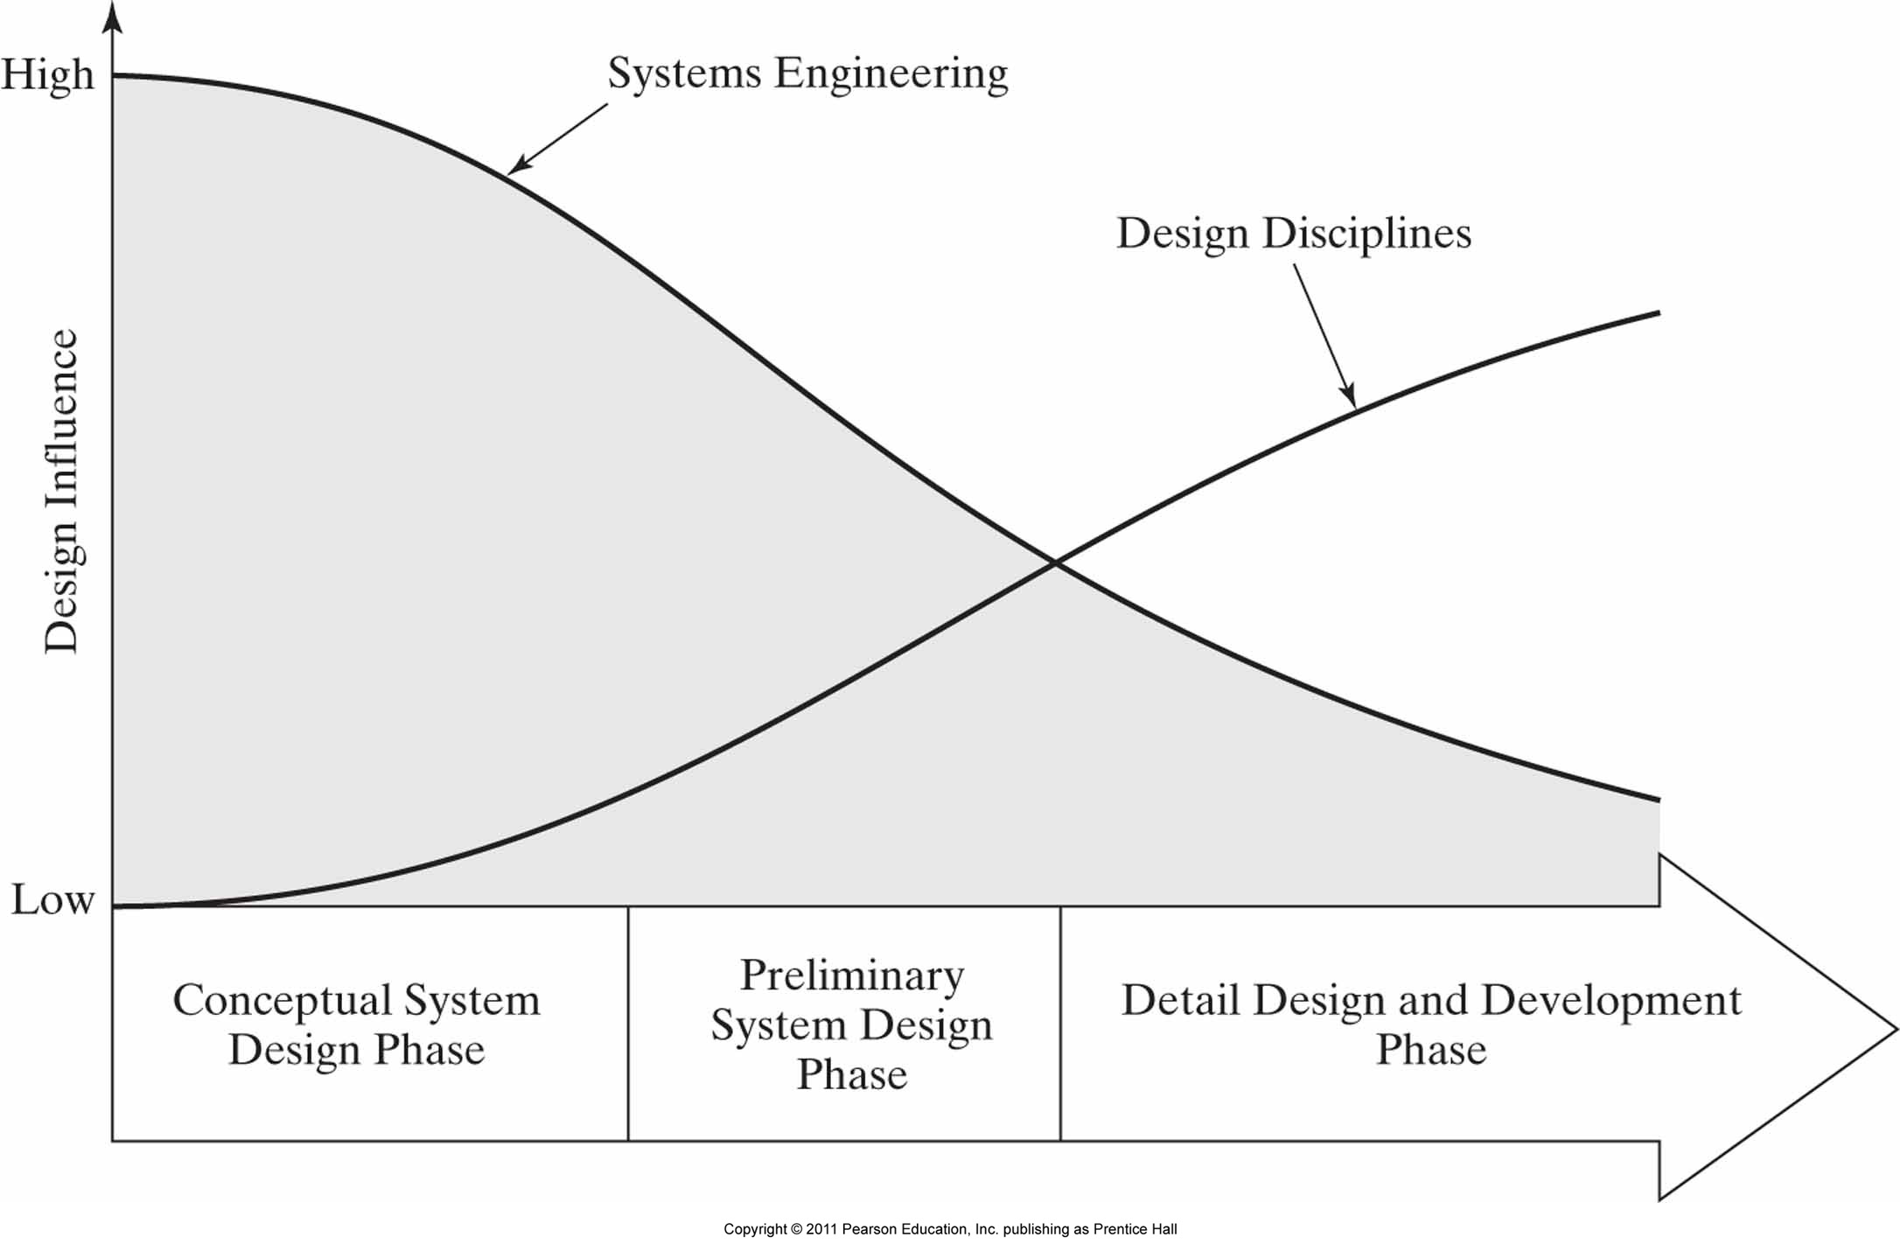
Systems Engineering Vs. Engineering Discipline Influence On Design

